Slide 1



UG PROJECT 2021-22:: FINAL VIVA - VOCE
Facial Features Based Human Age,Gender And Ethnicity Identification System
Supervisor
DR S Veluchamy
Assistant Professor
Department of ECE
Members of students:
Shivaganesan K (Reg. No.: 180701114)
Shruthi E (Reg. No.: 180701116)
Yashwin Vasanth S (Reg. No.: 180701154)

Slide 2
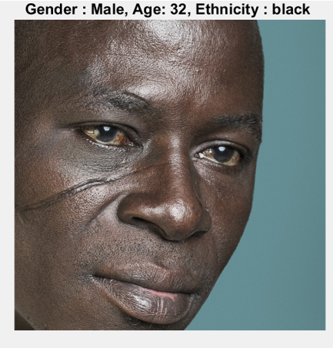
OBJECTIVES
To design an Autonomous Age Approximation, Gender and Ethnicity Prediction System based on facial features.
To reduce false prediction and improve accuracy, we incorporate Deep Learning technique.

Slide 3
LITERATURE SURVEY
PAPER | AUTHOR | YEAR | PROBLEM STATEMENT | RESULT
Gender & Emotion recognition using CNN | Arjun Singh | 2021 | Two models, one for age-gender prediction using wide resnet architecture and the other model is trained for emotion recognition | Gender classification is 96.26 emotion recognition has the accuracy of 69.5%
Age and Gender Prediction Using Attentional Convolutional Network | Amirali Abdolrashidi | 2020 | To propose a deep learning framework, based on the ensemble of attentional and residual convolutional networks, to predict gender and age | Focused on only the most salient part of the face
Deeply Learned Classifiers for Age Gender Predictions of Unfiltered Faces. | Serestina Viriri. | 2020 | To propose a novel end-to-end deep learning-based classification model that predicts age group and gender of unfiltered in-the-wild facial images | Robust image preprocessing algorithm, handled only some of the variability observed

Slide 4
LITERATURE SURVEY
PAPER | AUTHOR | YEAR | PROBLEM STATEMENT | RESULT
Age and Gender Detection using Python | Mohd Rafey | 2020 | To implement python deep learning for age and gender estimation | Detects a human face like object as a legit human face when non human object is given as input
Deep-Learning For Gender Classification/Age Estimation | TU Wien | 2018 | To train and evaluate a given convolutional neural network to accomplish gender classification and age estimation on images found in the web | Higher complexity arises due to the claim to classify in-the-wild images
Race Classification Using Deep Learning | Khalil Khan | 2021 | To propose a race-classification algorithm using a prior face segmentation framework using a deep convolutional neural network (DCNN). | Obtained classification accuracies of 100%, 99.2%, 92.0%, and 93.2% for the FERET, CAS-PEAL, VNFaces, and VMER datasets, respectively.

Slide 5
PROBLEM STATEMENT
Automatically detecting the gender of the person, estimating the age or predicting the ethnicity is valuable in many fields of work.
A higher complexity arises due to the claim to classify in-the-wild images, i.e. pictures which do not fulfill certain restrictions.
The reliability of the existing solutions mostly based on machine learning, remains insufficient for practical application.
GOAL:
The goal of this work is to train and evaluate a given convolutional neural network to accomplish gender, age and ethinicity classification on images with transfer learning method.

Slide 6
DESIGN CHALLENGES
It is perceivable that our system may wrongly classify due to extremely challenging viewing conditions of the internet images.
Gender estimations might occasionally be wildly off for infant age group.
Gender and age estimation might occasionally be wronlgy classified due to extra accessories such as masks, specs, etc.
Identifying race, which is a major physical feature in humans, is a challenging task owing much to the lack of a concrete definition of race and the diversity of population across the globe

Slide 7
THEORITICAL BACKGROUND
VGG FACE AND VGG 16
VGG Face is a dataset of 2.6 million face images of 2,622 people that is used development face recognition technology.
VGG16 is a convolution neural net (CNN) architecture which is trained from scratch for facial recognition using VGG Face Dataset.
Since facial recognition neural networks (VGG) have already been trained to distinguish human features, the features that they extract may be more useful for determining age and gender from a photo than the features extracted by a more general neural network.

Slide 8
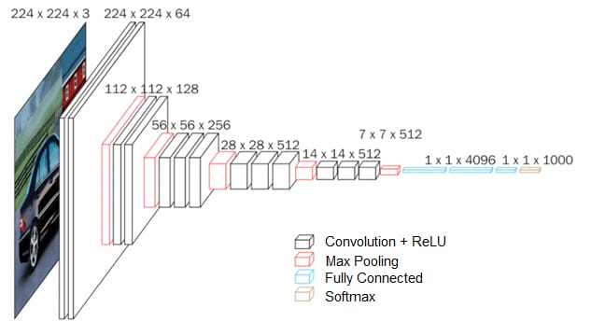
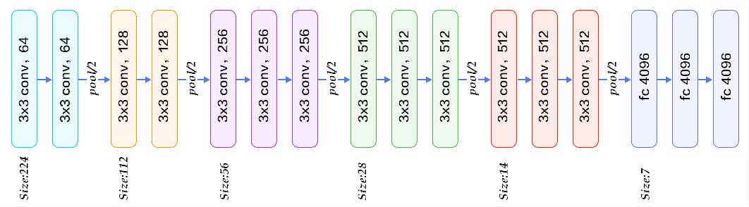
VGG 16 ARCHITECTURE

Slide 9
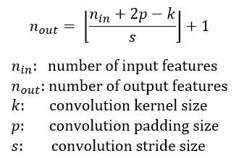
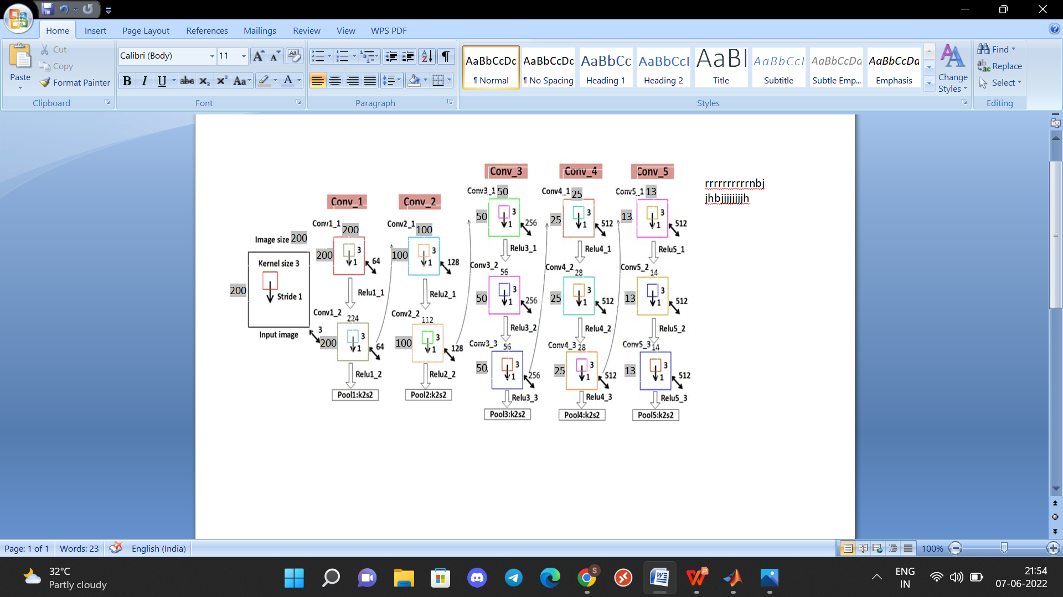
VGG 16 ARCHITECTURE
Here we use,
Convolution layer of 3x3 kernal ,stride 1x1 and padding(1),starting with 200x200 input features.
Maxpool layer of 2x2 pool size and stride 2x2 and has no zero padding

Slide 10
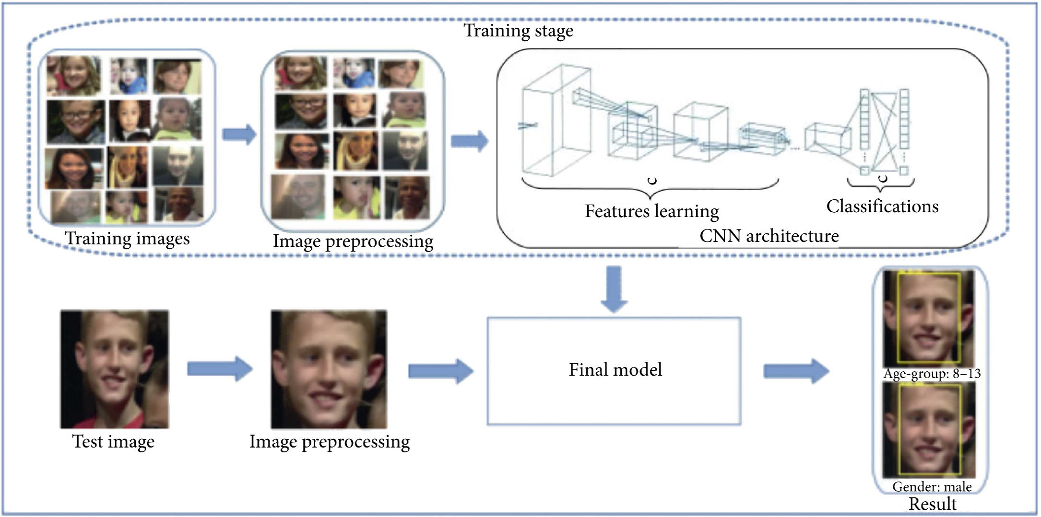
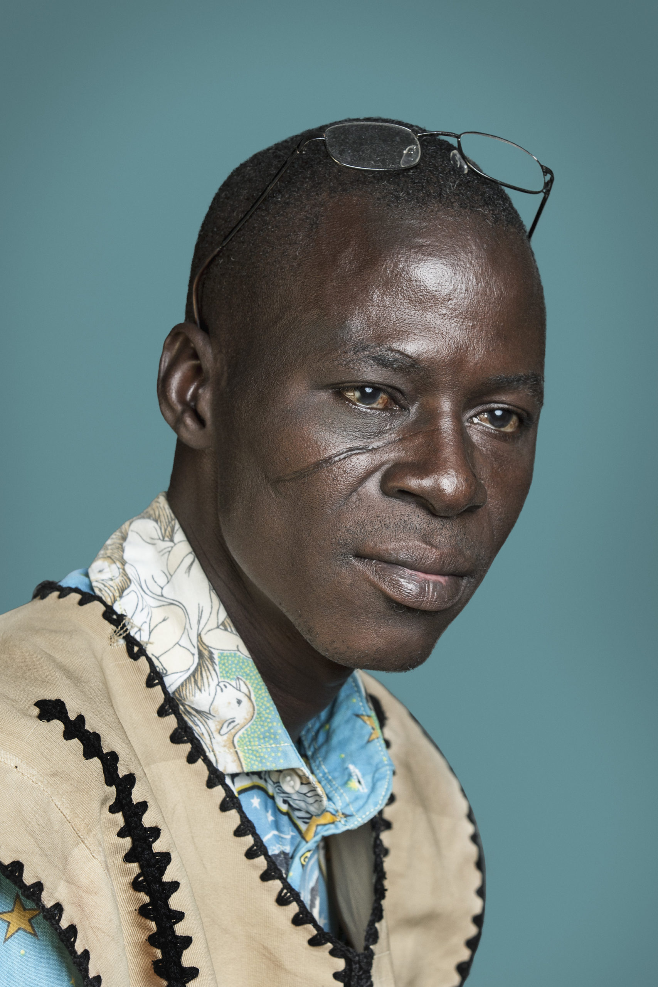
BLOCK DIAGRAM

Slide 11
IMPLEMENTATION ASPECTS
DETECT FACES:
When given a frame/video, the CNN algorithm first detects for faces in each frame.
CLASSIFY INTO MALE/FEMALE:
Once it finds faces in the frame, the features of the faces are extracted, and the gender is determined.
Based on the different parts of facial feature extraction, the gender classification via face can be divided into local feature extraction and global feature extraction methods.
The local feature extraction method extracts features from certain facial points like the mouth, nose and eyes, whereas the global features extraction method extracts features from the whole face instead of extracting features from facial points.

Slide 12
IMPLEMENTATION ASPECTS
CLASSIFY INTO ONE OF THE AGE RANGES:
The age of the faces is determined and falls under either of the age ranges for example [(1-2), (4-6), (10-12), (19-21), (31-33), (40-42), (52-54), (73-75),(97-99)].
CLASSIFY INTO ONE OF THE ETHNICITY CLASSES:
The ethnicity of the faces is determined and falls under either of the ethnicity classes such as Asian, Black, Indian and White.
PUT THE RESULTS ON THE FRAME AND DISPLAY IT:
The result is displayed on the frame containing the age range, gender and ethnicity. The resulting frame consists of the faces with the estimated age, gender and ethnicity.

Slide 13
AGE DATA SET DESCRIPTION
Age group | Train | Test | Total
1--3 | 1497 | 374 | 1871
4--6 | 443 | 111 | 554
7--9 | 417 | 104 | 521
10--12 | 247 | 62 | 309
13--15 | 248 | 62 | 310
16--18 | 397 | 99 | 496
19--21 | 259 | 65 | 324
22--24 | 338 | 84 | 422
25--27 | 449 | 112 | 561
28--30 | 325 | 81 | 406
31--33 | 234 | 59 | 293
34--36 | 261 | 65 | 326
37--39 | 259 | 65 | 324
40--42 | 150 | 38 | 188
43--45 | 132 | 33 | 165
46--48 | 156 | 39 | 195
49--51 | 215 | 54 | 269
Age group | Train | Test | Total
52--54 | 298 | 74 | 372
55--57 | 195 | 49 | 244
58--60 | 234 | 59 | 293
61--63 | 138 | 35 | 173
64--66 | 157 | 39 | 196
67--69 | 120 | 30 | 150
70--72 | 116 | 29 | 145
73--75 | 107 | 27 | 134
76--78 | 67 | 17 | 84
79--81 | 78 | 19 | 97
82--84 | 38 | 9 | 47
85--87 | 126 | 31 | 157
88--90 | 71 | 18 | 89
91--93 | 14 | 3 | 17
94--96 | 15 | 4 | 19
97--99 | 2 | 0 | 2
100-102 | 4 | 1 | 5

Slide 14
AGE - COMPARISON OF ACCURACY OF DIFFERENT MODELS
ARCHICTECTURE | ACCURACY |  | VALIDATION ERROR
 | Epoch 50 (in %) | Epoch 120 (in %) | Epoch 50 (in %) | Epoch 120(in %)
Vgg 16 | 65 | 82 | 73.96 | 72.57
Resnet 50 | 66 | 80 | 73.75 | 33.16

Slide 15
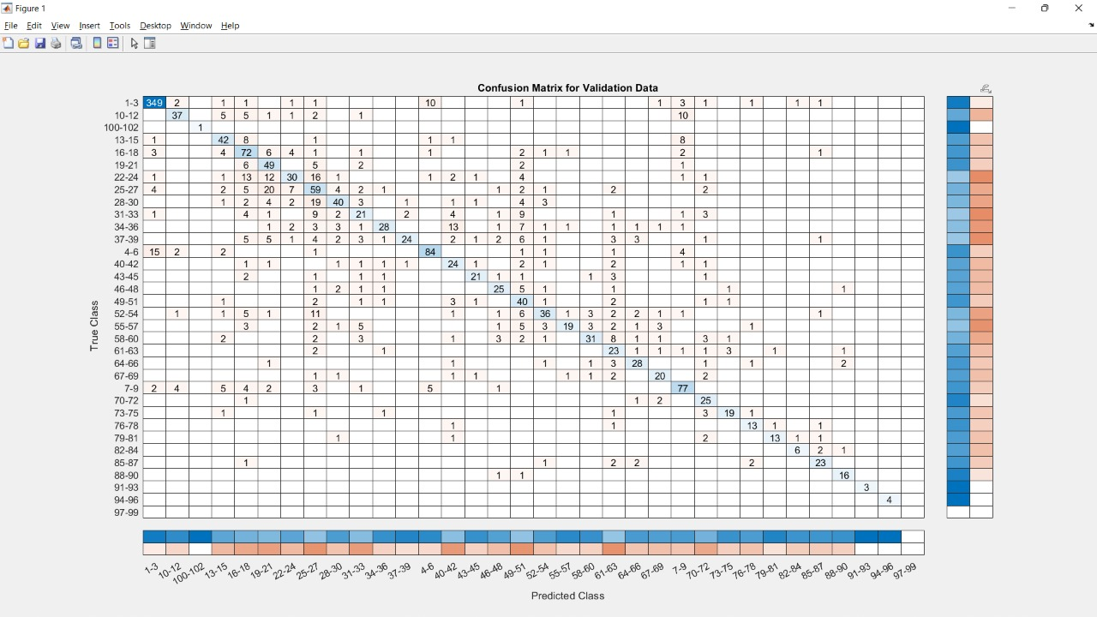
AGE CONFUSION MATRIX - RESNET 50

Slide 16
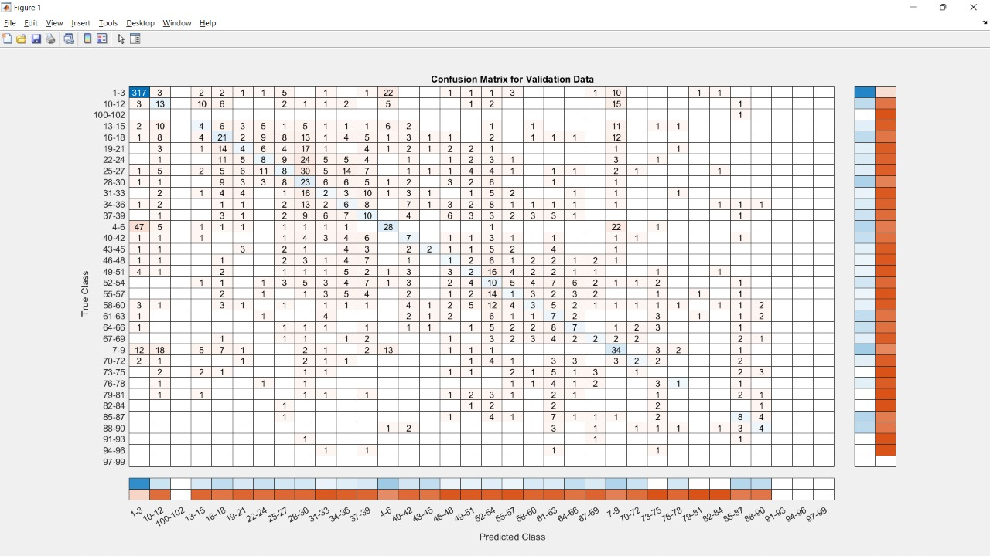
AGE CONFUSION MATRIX - VGG 16

Slide 17
GENDER DATA SET DESCRIPTION
Gender group | Train | Test | Total
Male | 3566 | 891 | 4457
Female | 4332 | 1083 | 5415

Slide 18
GENDER - COMPARISON OF ACCURACY OF DIFFERENT MODELS
ARCHICTECTURE | ACCURACY |  | VALIDATION ERROR
 | Epoch 50 (in %) | Epoch 120 (in %) | Epoch 50 (in %) | Epoch 120(in %)
Vgg 16 | 95.31 | 95.31 | 20.36 | 21.07
Resnet 50 | 93 | 93.75 | 8.81 | 20.41

Slide 19
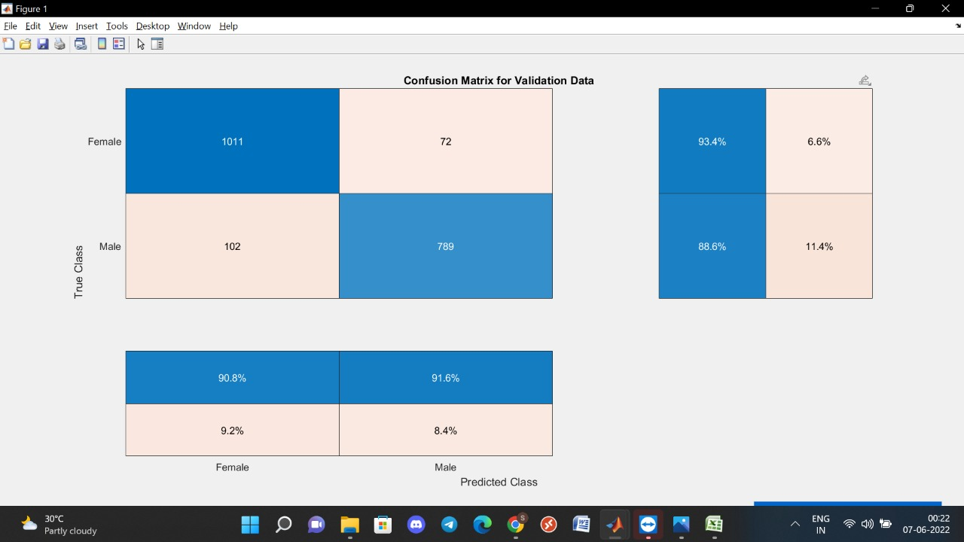
GENDER CONFUSION MATRIX RESNET - 50

Slide 20
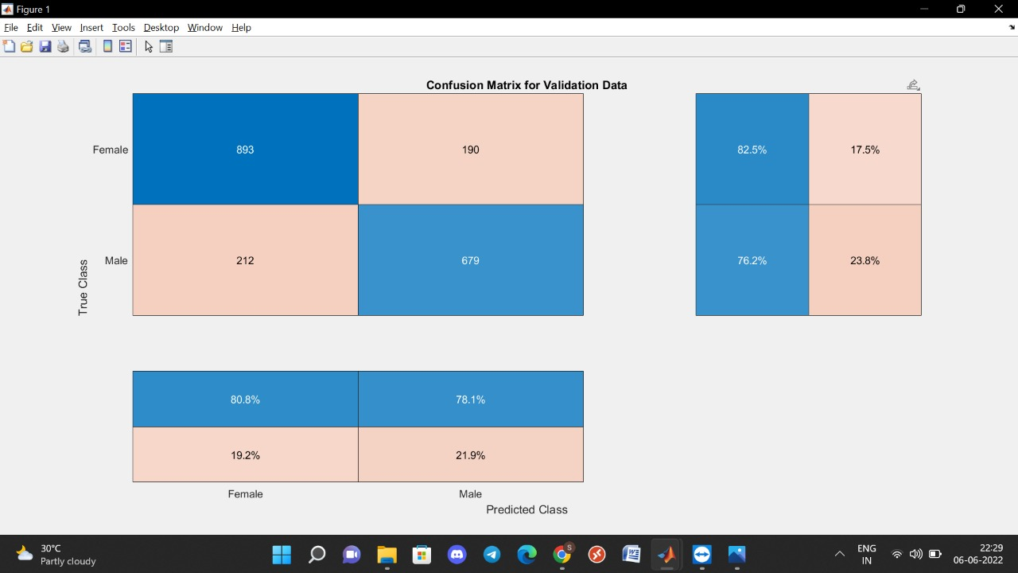
GENDER CONFUSION MATRIX VGG - 16

Slide 21
RACE DATASET DESCRIPTION
Race group | Train | Test | Total
Asian | 470 | 118 | 588
Black | 190 | 48 | 238
Indian | 816 | 204 | 1020
White | 2738 | 685 | 3423

Slide 22
RACE-COMPARISON OF ACCURACY OF DIFFERENT MODELS
ARCHICTECTURE | ACCURACY |  | VALIDATION ERROR
 | Epoch 50 (in %) | Epoch 120 (in %) | Epoch 50 (in %) | Epoch 120(in %)
Vgg 16 | 98.44 | 98.44 | 18.57 | 3.06
Resnet 50 | 96.88 | 98.44 | 19.33 | 15.50

Slide 23
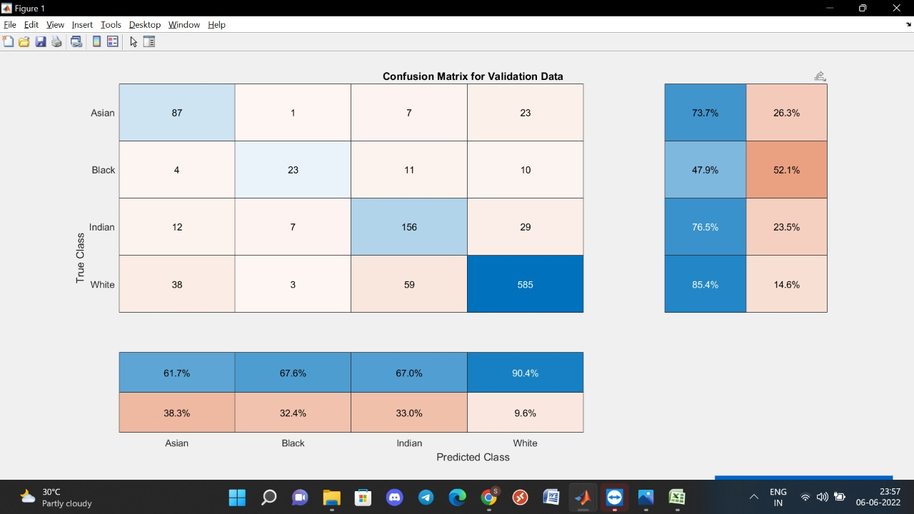
RACE CONFUSION MATRIX RESNET - 50

Slide 24
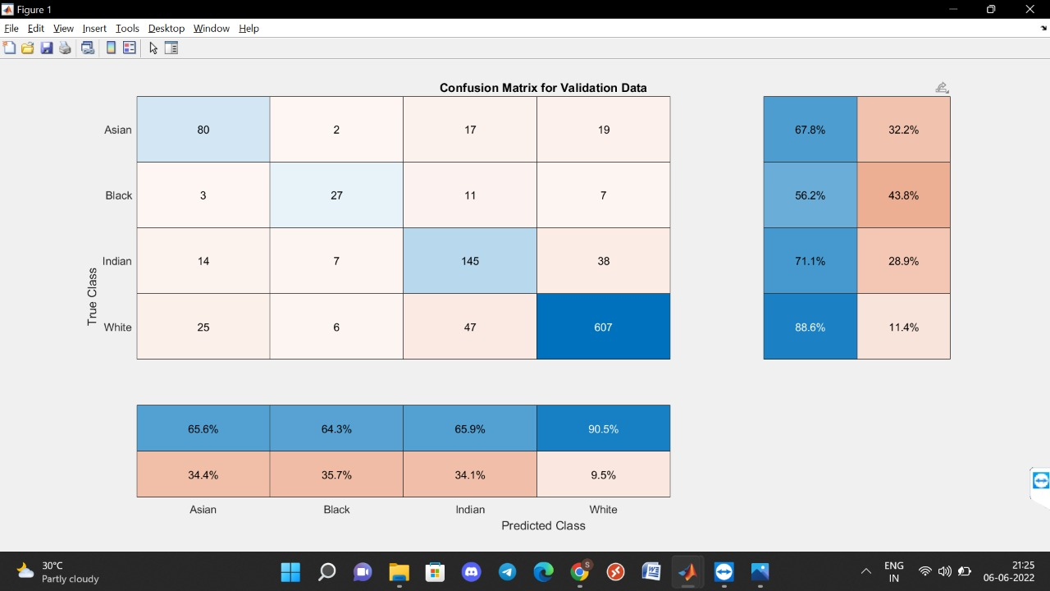
RACE CONFUSION MATRIX VGG - 16

Slide 25
APPLICATIONS
Face recognition security systems (Biometrics)
Criminal profiling (Forensic art)
Better integration of artificial assistants in personal life
Finding lost children
Surveillance monitoring
Electronic customer relationship management

Slide 26
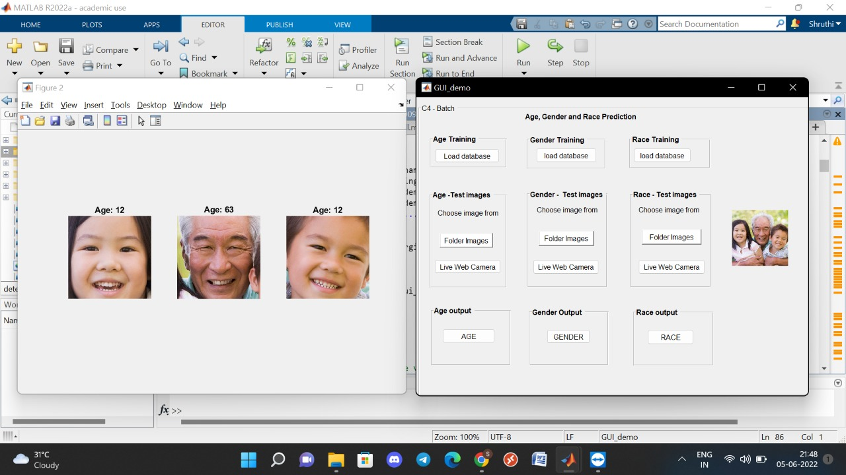
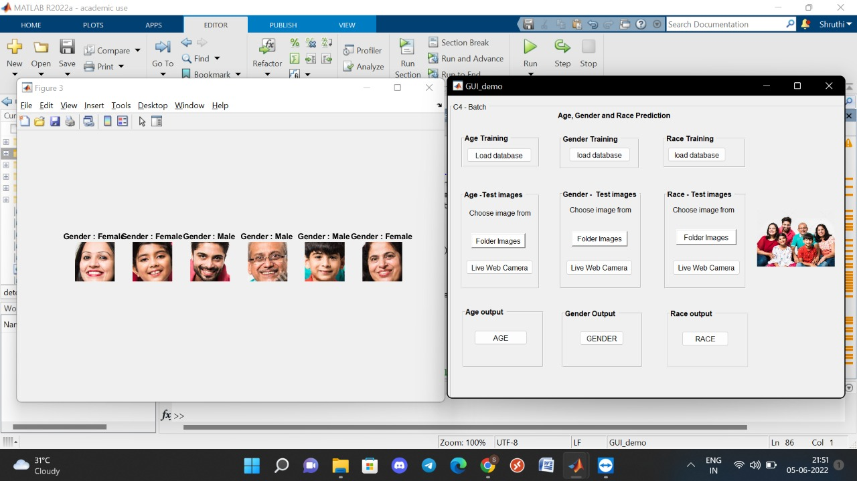
OUTPUT

Slide 27
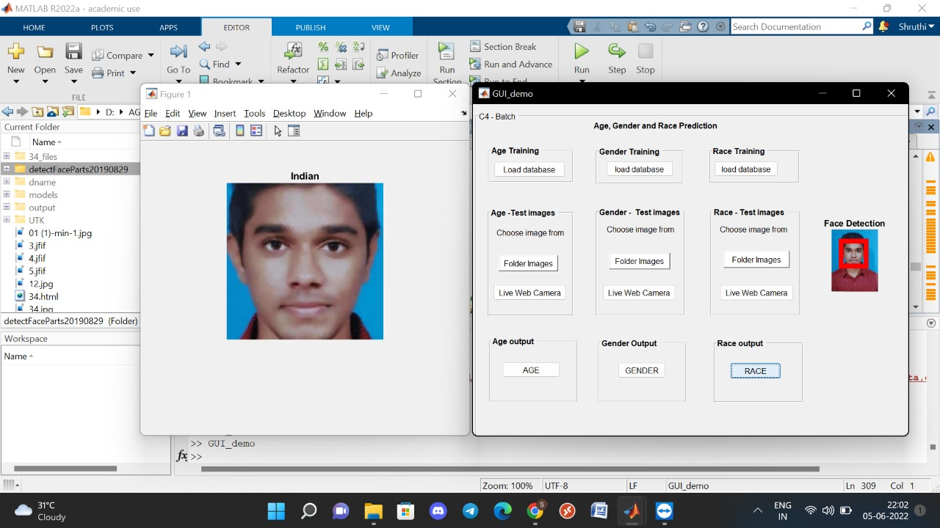
OUTPUT

Slide 28
CONCLUSION AND FUTURE WORKS
This study proposes a generic framework for estimating automatic identification (age, gender, and race) using a database of face photos.
The proposed approach utilizes a superior system performance in order to increase the estimation accuracy of demographic variables.
It demonstrates that the suggested facial features-based Gender, Age, and Ethnicity estimation outperforms the majority of state-of-the-art techniques in UTK databases.
In addition, the proposed method performed admirably in the difficult databases.
In future different optimization and regularisation functions can be incorporated to the proposed system to increase the accuracy and also decrease the false prediction rate.

Slide 29
REFERENCES
Akhand, M. A., Sayim, M. I., Roy, S., & Siddique, N. (2020). Human Age Prediction from Facial Image Using Transfer Learning in Deep Convolutional Neural Networks. Proceedings of International Joint Conference on Computational Intelligence Algorithms for Intelligent Sys-tems, 217-229. doi:10.1007/978-981-15-3607-6_1
M. R. Dileep and A. Danti, “Human age and gender prediction based on neural networks and three human age gender prediction based on neural networks and three sigma control limits,” Applied Artificial intelligence, vol. 32, no. 3, pp. 281–292, 2018.
Angulu, R., Tapamo, J. R., & Adewumi, A. O. (2018). Age estimation via face images: A survey. EURASIP Journal on Image and Video Processing, 2018(1). doi:10.1186/s13640-018-0278-6
G. Antipov , M.Baccouche, J. Dugelay , Effective Training of Convolutional Neural Networks for Face-Based Gender and Age Prediction , Pattern Recognition Volume 72 , 2017
Lagree, S., & Bowyer, K. W. (2020, November). Predicting ethnicity and gender from iris texture. In 2020 IEEE international conference on technologies for homeland security (Hst) (pp. 440-445). IEEE.

Slide 30
THANK YOU

